Slide 1



Saudi Arabia Weather MapReduce
Black Belts
Abdulaziz Otaif Mohammed Alhaddad Elham AlGhamdi
Reem Alsabti Esraa AlZahrani Norah Jadkarim

Slide 2
Table of Contents
1
Introduction
2
Dataset overview
3
MapReduce
4
Future work

Slide 3

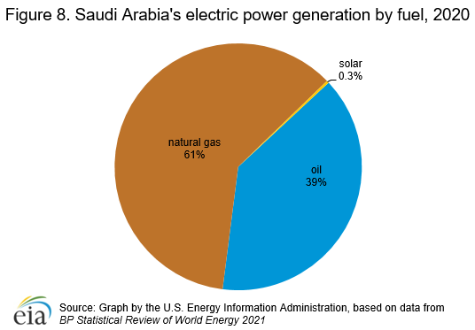
VISION 2030
Saudi Vision 2030 aims to achieve a renewable and sustainable energy supply of 9.5 GW by 2030.
The contribution of renewable energy to the overall energy mix will reach up to 50% of all energy supply in Saudi Arabia.

Slide 4

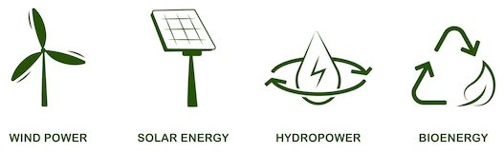
Goal
Understand frequent weather conditions across the kingdom.
To determine what is the most suitable renewable energy sources for each city

Slide 5

Dataset Overview

Slide 6
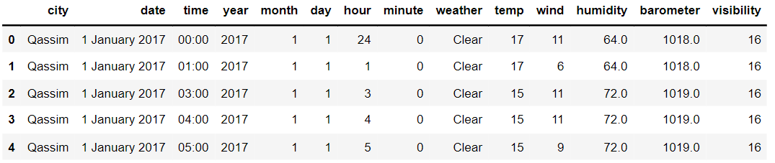
Overview

Slide 7
Description
The dataset consists of 14 attributes and 249k+ instances.
The attributes can be classified into three subcategories:
Place of collection
Time and Date
Condition & Metrics
City
time, year, month, day, hour, minute
Weather, temp, wind, humidity, barometer, visibility

Slide 8
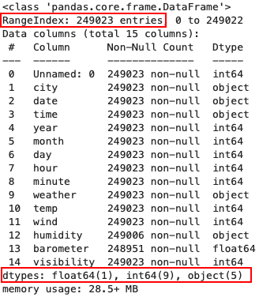
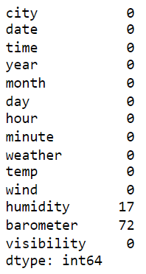
Description
Columns
Missing

Slide 9
MapReduce

Slide 10
Objective #1
Find the most frequent weather in each city
By counting occurrences of each city with each weather conditions
"Jazan" ["Clear ", 7621]
"Madina" ["Clear ", 8668]
"Mecca“ ["Clear ", 7581]
"Najran" ["Clear ", 7675]
…
..
.

Slide 11
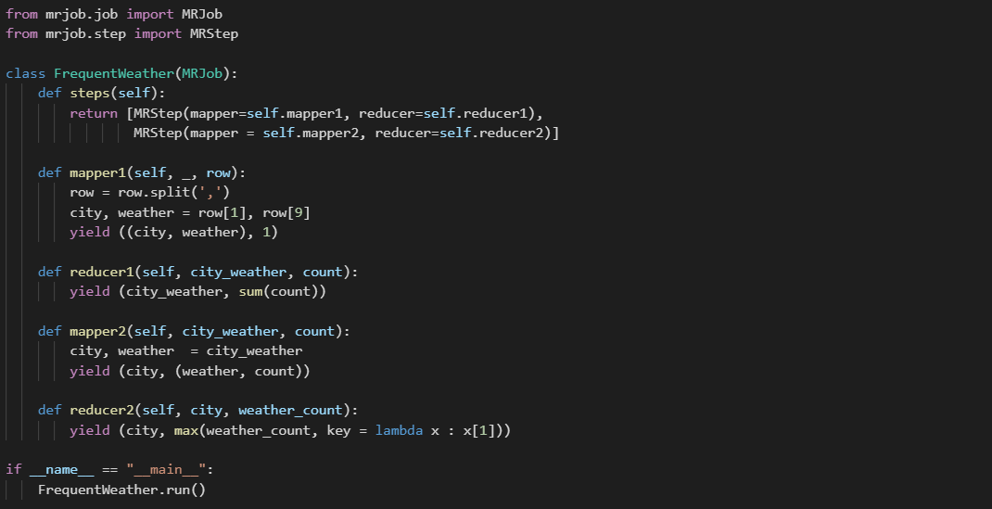
Objective #1 - Script

Slide 12
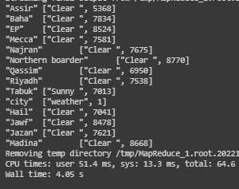
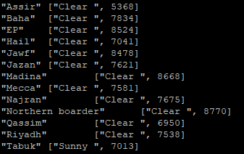

Objective #1 - Results
Colab
Hadoop

Slide 13
Objective #2
Most frequent wind speed in each city
By counting occurrences of each city with each wind speed value
"Jawf" ["7", 2784]
"Jazan" ["0", 3710]
"Madina" ["0", 3336]
"Mecca" ["19", 3015]
…
..
.

Slide 14
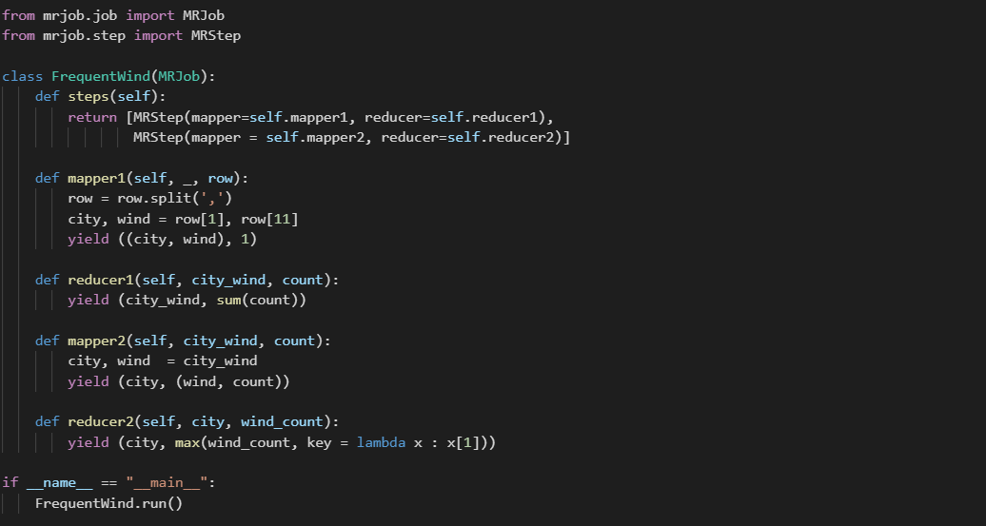
Objective #2 - Script

Slide 15
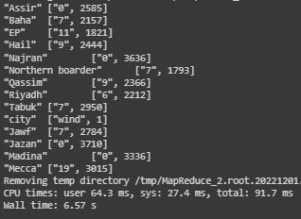
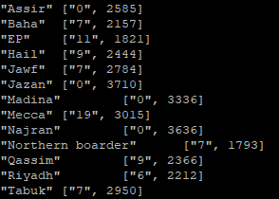

Objective #2 - Result
Colab
Hadoop

Slide 16
Objective #3
Most frequent temperature in each city
By counting occurrences of each city with each temperature degree value.
“Jazan " ["22", 1291]
"Madina " ["33", 820]
"Mecca " ["30", 1576]
"Najran " ["22", 1308]
…
..
.

Slide 17
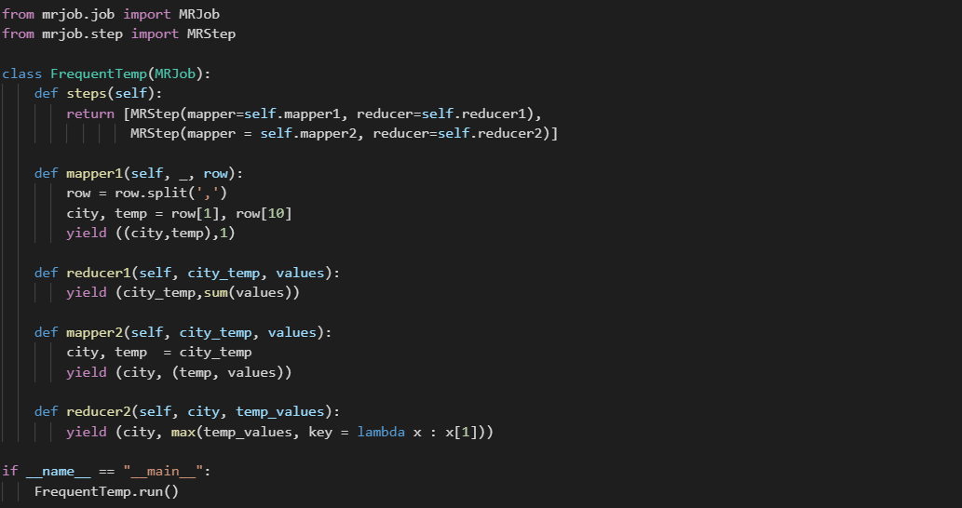
Objective #3- Script

Slide 18
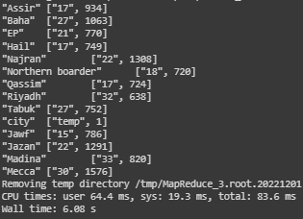
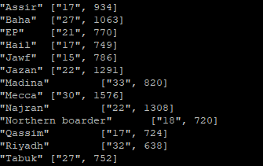

Objective #3 - Result
Colab
Hadoop

Slide 19
Objective #4
Most frequent weather in each month
By counting occurrences of each month with each weather conditions.
"1" ["Clear ", 12198]
"2" ["Clear ", 8925]
"3" ["Clear ", 11130]
"4" ["Clear ", 9398]
…
..
.

Slide 20
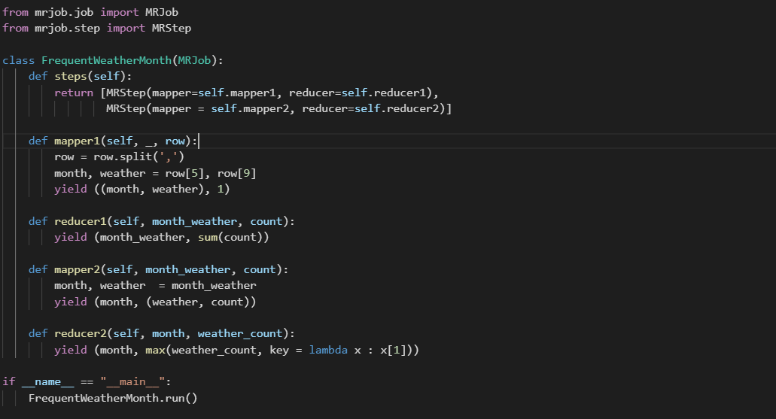
Objective #4 - Script

Slide 21
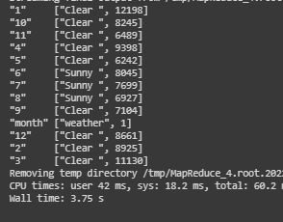
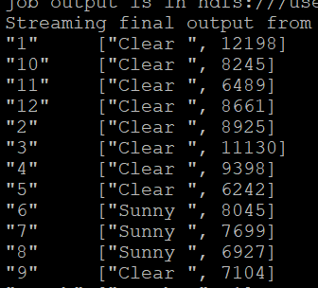

Objective #4 - Result
Colab
Hadoop

Slide 22


Recommendations For Future Work
Improve Hadoop MapReduce environment by:
Tuning performance the CPU, memory, disk, and network...
Minimizing spilling by compression of mapper output
Reuse jvm task
Use Combine file input format for bunch of smaller files.
Use other aggregate functions such as min, max, and average to find more useful results.

Slide 23
Thank You!
Any Questions ?

